Slide 1
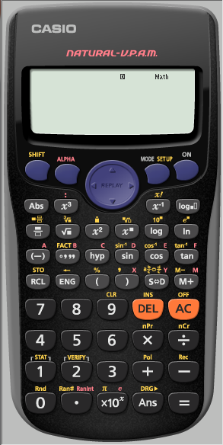
Finding Standard Deviation
Find the
Standard Deviation of
6,5,5,4,5,5,6,5 and 4
We first need to make sure
the calculator is CLeaR of all
previous content

Slide 2
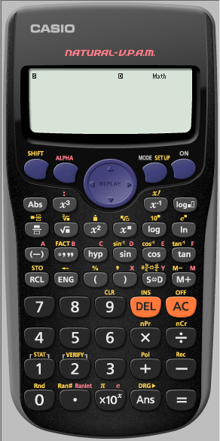
Finding Standard Deviation
Find the
Standard Deviation of
6,5,5,4,5,5,6,5 and 4
We first need to make sure
the calculator is CLeaR of all
previous content

Slide 3
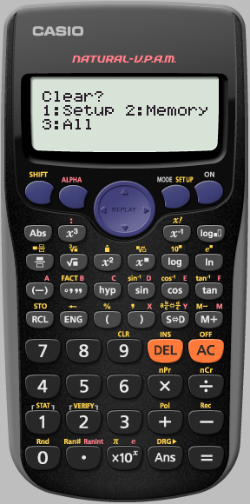
Finding Standard Deviation
Find the
Standard Deviation of
6,5,5,4,5,5,6,5 and 4
We want to clear ALL

Slide 4
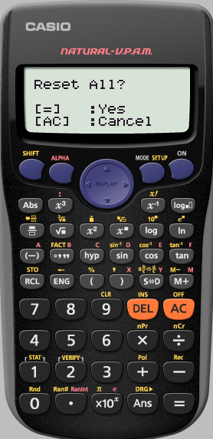
Finding Standard Deviation
Find the
Standard Deviation of
6,5,5,4,5,5,6,5 and 4
Yes reset all

Slide 5
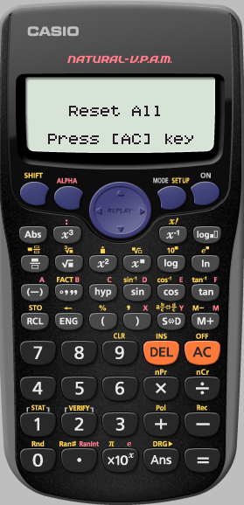
Finding Standard Deviation
Find the
Standard Deviation of
6,5,5,4,5,5,6,5 and 4
We really do agree
AC

Slide 6
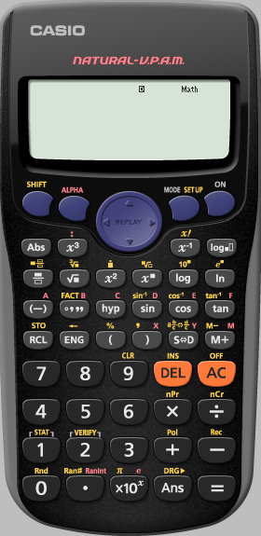
Finding Standard Deviation
Find the
Standard Deviation of
6,5,5,4,5,5,6,5 and 4
We want the calculator
in STATS mode

Slide 7
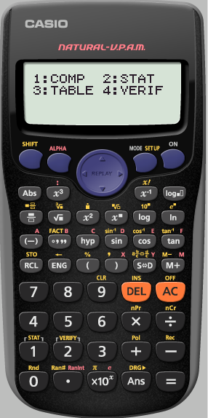
Finding Standard Deviation
Find the
Standard Deviation of
6,5,5,4,5,5,6,5 and 4
We want the calculator
in STATS mode

Slide 8
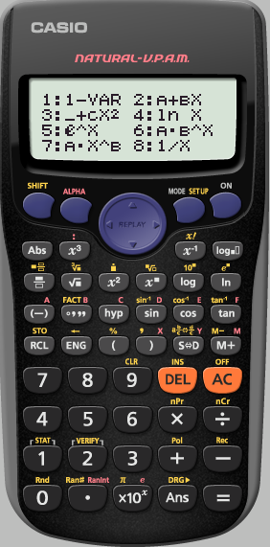
Finding Standard Deviation
Find the
Standard Deviation of
6,5,5,4,5,5,6,5 and 4
We only have 1 variable

Slide 9
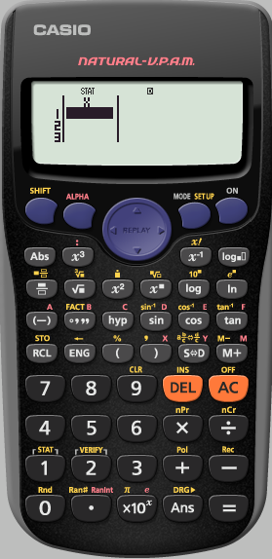
Finding Standard Deviation
Find the
Standard Deviation of
6,5,5,4,5,5,6,5 and 4
We now input
our data pressing
=
after each term

Slide 10
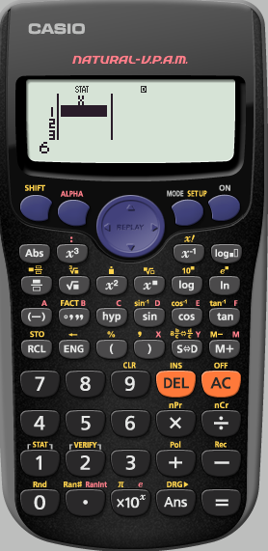
Finding Standard Deviation
Find the
Standard Deviation of
6,5,5,4,5,5,6,5 and 4

Slide 11
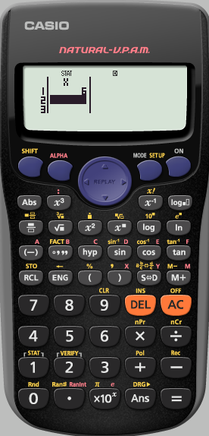
Finding Standard Deviation
Find the
Standard Deviation of
6,5,5,4,5,5,6,5 and 4

Slide 12
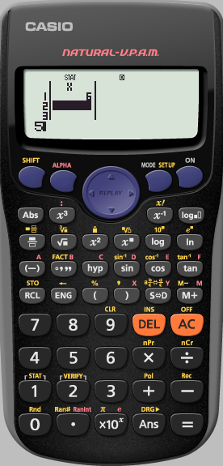
Finding Standard Deviation
Find the
Standard Deviation of
6,5,5,4,5,5,6,5 and 4

Slide 13
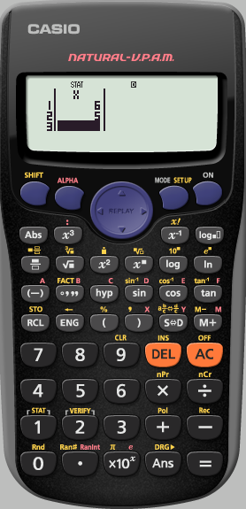
Finding Standard Deviation
Find the
Standard Deviation of
6,5,5,4,5,5,6,5 and 4
Repeat this process
until the data is entered

Slide 14
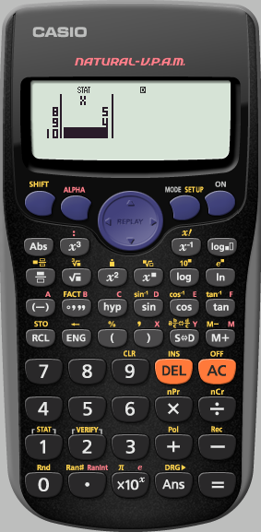
Finding Standard Deviation
Find the
Standard Deviation of
6,5,5,4,5,5,6,5 and 4
We have finished inputting the data.
We now need to get to where we can analyse it
Press
AC

Slide 15
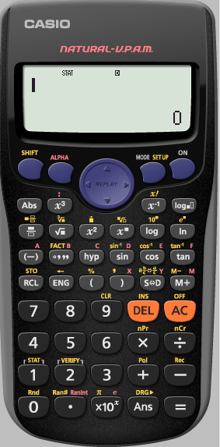
Finding Standard Deviation
Find the
Standard Deviation of
6,5,5,4,5,5,6,5 and 4
We need to analyse
the STATS we have input

Slide 16
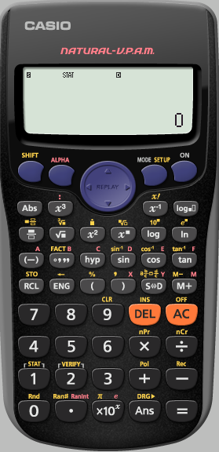
Finding Standard Deviation
Find the
Standard Deviation of
6,5,5,4,5,5,6,5 and 4
We need to analyse
the STATS we have input

Slide 17
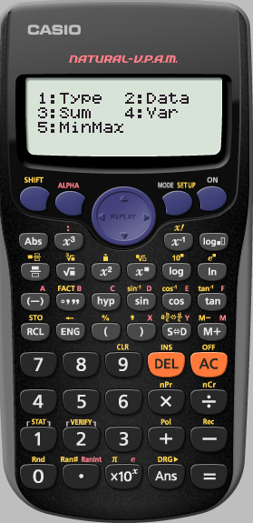
Finding Standard Deviation
Find the
Standard Deviation of
6,5,5,4,5,5,6,5 and 4
We want to see the
Variance

Slide 18
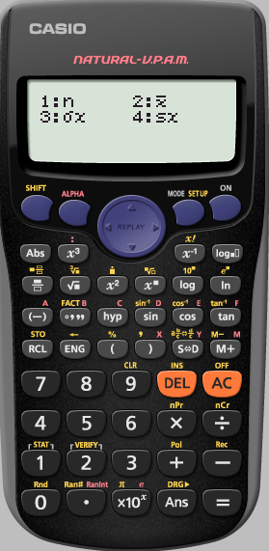
Finding Standard Deviation
Find the
Standard Deviation of
6,5,5,4,5,5,6,5 and 4
n : The number of terms
: The mean of the terms
We want the
standard Deviation
σx
$$\overline{x}$$

Slide 19
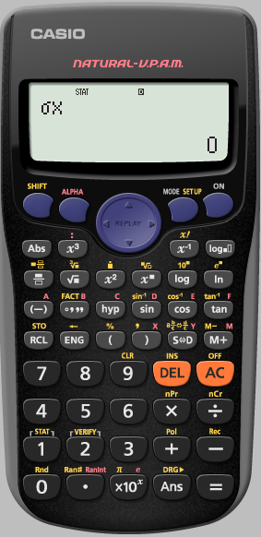
Finding Standard Deviation
Find the
Standard Deviation of
6,5,5,4,5,5,6,5 and 4

Slide 20
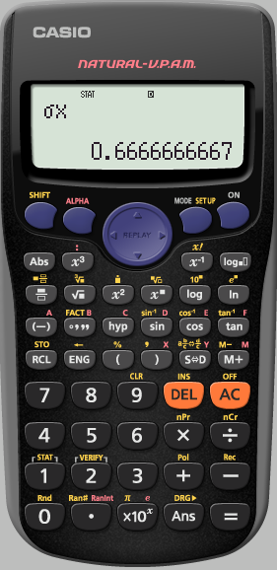
Finding Standard Deviation
Find the
Standard Deviation of
6,5,5,4,5,5,6,5 and 4
This is the
standard deviation
of the data set
To see more analysis details,
analyse the data again

